Slide 1
Phase 1: Memory Architecture & In-Place Mutation

Slide 2
Overview & Objectives
The Goal: Transition from "Coding" to "Data Engineering.“
The Requirement: Passing the Goldman Sachs "In-Place" challenge.
Key Concept: Understanding the Pointer Pattern.

Slide 3
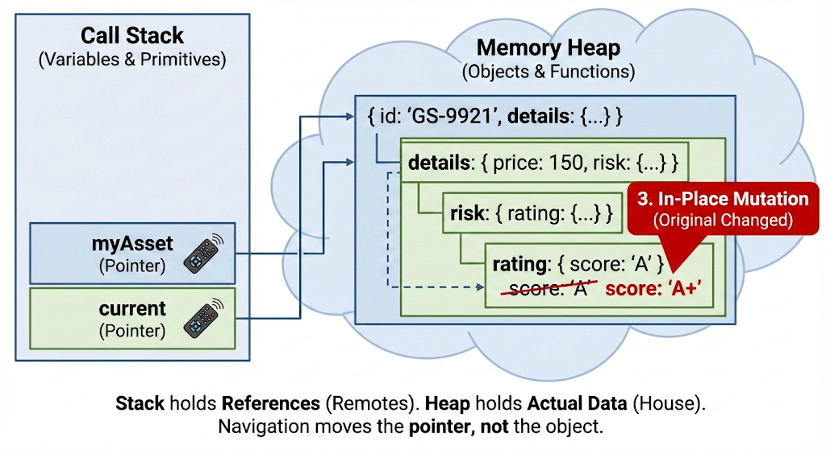
The Mental Model

Slide 4
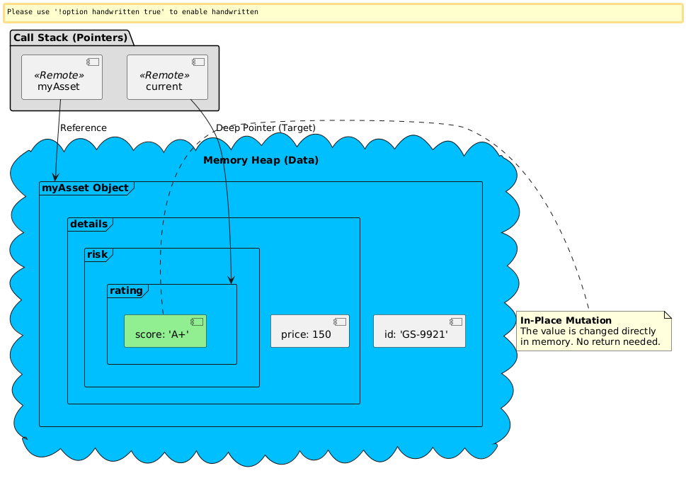
"If I have objA = {x: 1} and I set objB = objA, then I change objB.x = 2, what is the value of objA.x?"

Slide 5
Technical Red Flags (Interview Pitfalls)
typeof null: The historical JS bug that crashes recursive functions.
The Array Paradox: typeof [] is also "object".
The Reference Leak: obj2 = obj1
Reference Equality: Why {} === {} is false and what that means for state management.
Mutation vs. Cloning: When to change the "House" and when to build a new one.

Slide 6
Code-Along (The Asset Updater)
The Problem: Update risk.rating.score inside a complex asset.
The Constraint: No return statement allowed.
The Logic: split('.'), loop, and "pointer sliding."

Slide 7
Key Takeaways – Memory & Reference Mastery
The Reference Rule: Variables assigned to objects do not store the data;
they store a Pointer (Memory Address).
Reference Equality (===): Comparison checks the Address, not the Values.
Two identical-looking objects {} are never equal because they occupy different locations in the Heap.
In-Place Mutation: Modifying an object via a pointer changes the original "House" in memory.
No return value is needed to persist these changes.
The Pointer Sliding Pattern: To reach deep nested data,
move a temporary "current" variable level-by-level through the object tree.
Defensive Engineering: Always validate the path during traversal;
remember that typeof null is "object" and can crash your logic if not handled.

